Slide 1

EMPLOYEE ATTRITION PREDICTION
Group:
Hari chandan - 20034 Likhith reddy - 20039 Rithwik Sai - 20057

Slide 2


INTRODUCTION
NOWADAYS, FIRMS ARE EXPANDING AT A TREMENDOUS RATE, AND WITH THIS MASS EXPANSION, EXPERIENCED PROFESSIONALS ARE IN HIGH DEMAND BY THE COMPANIES. AN EXPERIENCED EMPLOYEE IS LIKE AN ASSET TO THE COMPANY; UPON LOSING, COMPANIES EITHER TRY TO RETAIN THE EMPLOYEE WITH A REVISED COMPENSATION, OR THEY CAN ALWAYS HIRE A NEW EMPLOYEE. HOWEVER, PREDICTING THIS CAN SAVE A LOT OF MONEY AND TIME. ADDITIONALLY, IT WILL ALLOW THE COMPANY'S MANAGEMENT TO CONTROL A PROJECT PIPELINE EFFICIENTLY, ENABLING THEM TO MANAGE THE HIRING AND EXISTING W O R K F O R C E FLEXIBLY.

Slide 3


MOTIVATION
AS THE COVID-19 KEEPS UNLEASHING ITS HAVOC, THE WORLD CONTINUES TO GET PUSHED INTO THE CRISIS OF THE GREAT ECONOMIC RECESSION, MORE AND MORE COMPANIES START TO CUT DOWN THEIR UNDERPERFORMING EMPLOYEES. COMPANIES FIRING HUNDREDS AND THOUSANDS OF EMPLOYEES IS A TYPICAL HEADLINE TODAY. CUTTING DOWN EMPLOYEES OR REDUCING AN EMPLOYEE SALARY IS A TOUGH DECISION TO TAKE. HERE IN THIS PROJECT WE LOOK AT VARIOUS PARAMETERS RESPONSIBLE FOR ATTRITION OF EMPLOYEE AND AT THE END WILL BUILD A MODEL TO PREDICT EMPLOYEE ATTRITION.

Slide 4
DATA SETS USED
THE VARIOUS COLUMNS ARE :
D - AN ANONYMOUS ID GIVEN TO AN EMPLOYEE
AGE - AGE OF AN EMPLOYEE
ATTRITION - DID THE EMPLOYEE LEAVE THE COMPANY, 0-NO, 1-YES BUSINESSTRAVEL - TRAVLLING FREQUENCY OF AN EMPLOYEE DEPARTMENT - WORK DEPARTMENT
DISTANCEFROMHOME - DISTANCE OF OFFICE FROM HOME EDUCATIONFIELD - FIELD OF EDUCATION
EMPLOYEENUMBER - NUMBER OF EMPLOYEES IN THE DIVISION OF A GIVEN EMPLOYEE ENVIRONMENTSATISFACTION - WORK ENVIRONMENT SATISFACTION
GENDER - GENDER OF EMPLOYEE MARTIALSTATUS - MARTIAL STATUS OF AN EMPLOYEE
MONTHLYINCOME - MONTHLY INCOME OF EMPLOYEE IN USD
NUMCOMPANIESWORKED - NUMBER OF COMPANIES IN WHICH EMPLOYEE HAS WORKED BEFORE JOINING THIS COMPANY OVERTIME - DOES THE PERSON WORK OVERTIME
PERCENTSALARYHIKE - AVERAGE ANNUAL SALARY HIKE IN PERCENTAGES STOCKOPTIONLEVEL - COMPANY STOCKS GIVEN TO AN EMPLOYEE TOTALWORKINGYEARS - TOTAL WORKING EXPERIENCE OF AN EMPLOYEE
TRAININGTIMESLASTYEAR - NO. OF TRAININGS AN EMPLOYEE WENT THROUGH LAST YEAR YEARSATCOMPANY - NUMBER OF YEARS WORKED AT THIS COMPANY YEARSINCURRENTROLE - NUMBER OF YEARS IN CURRENT ROLE YEARSSINCELASTPROMOTION - NUMBER OF YEARS SINCE LAST PROMOTION YEARSWITHCURRMANAGER - NUMBER OF YEARS WITH THE CURRENT MANAGER

Slide 5
The datasets we are using are already pre-processed which doesn't have any missing values, null values and no wrong categorical values.

Slide 6
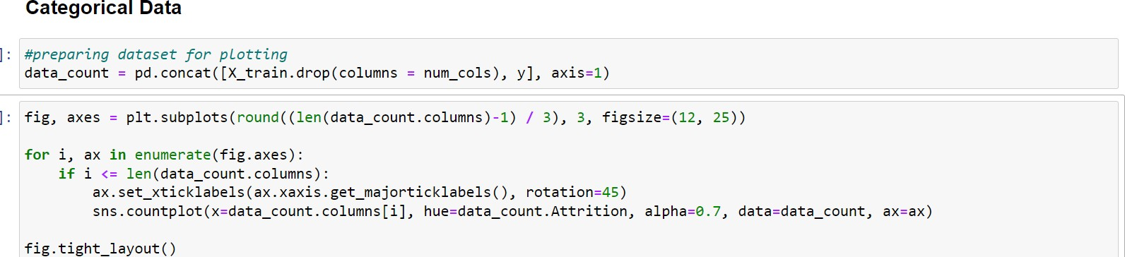
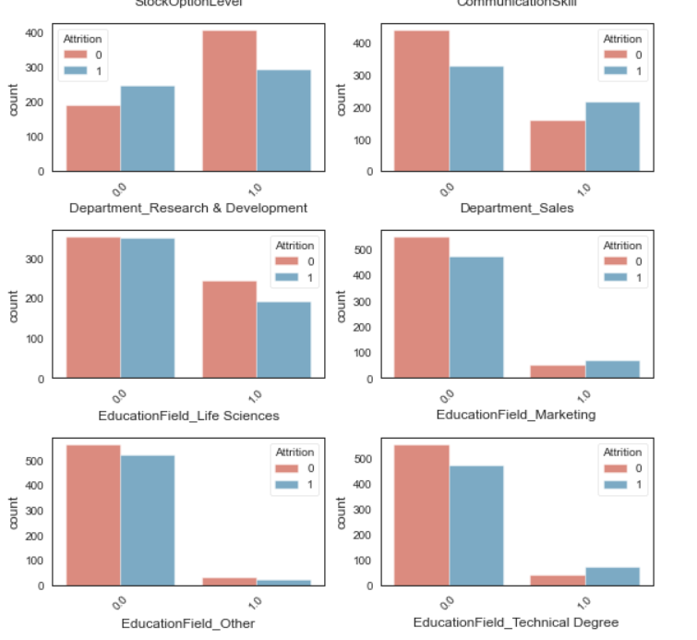
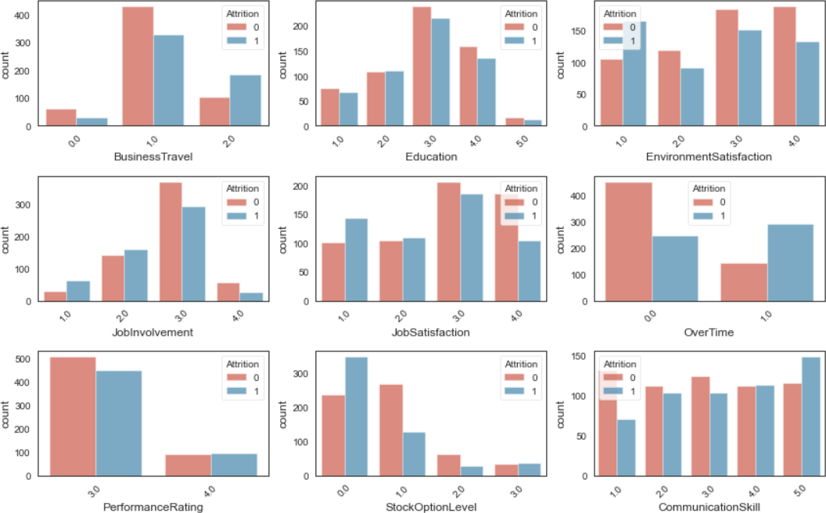

Slide 7
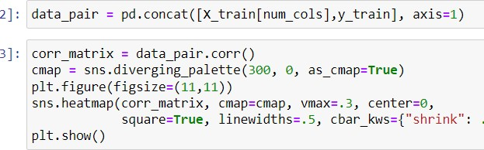
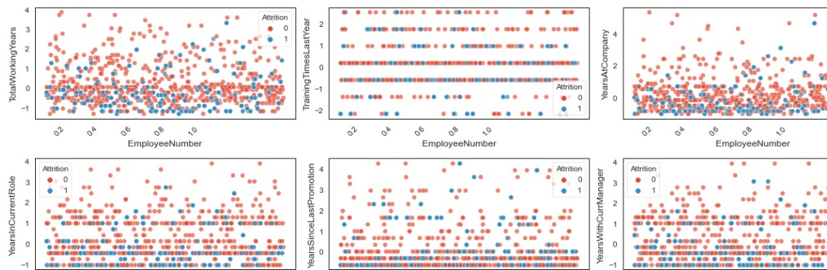
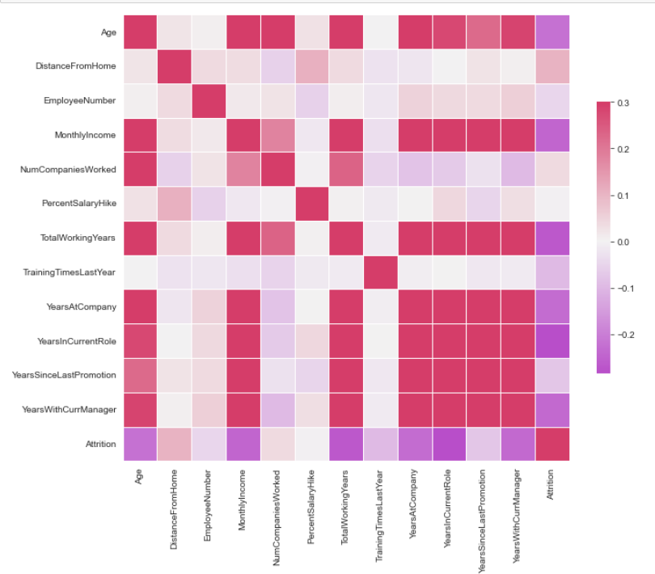
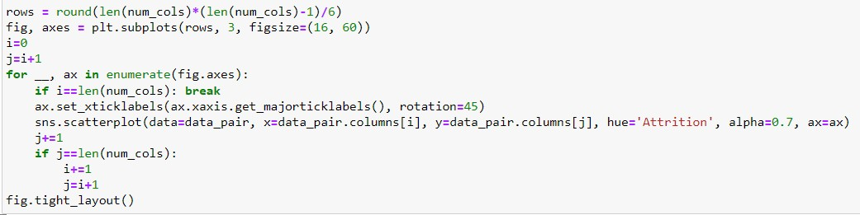

Slide 8
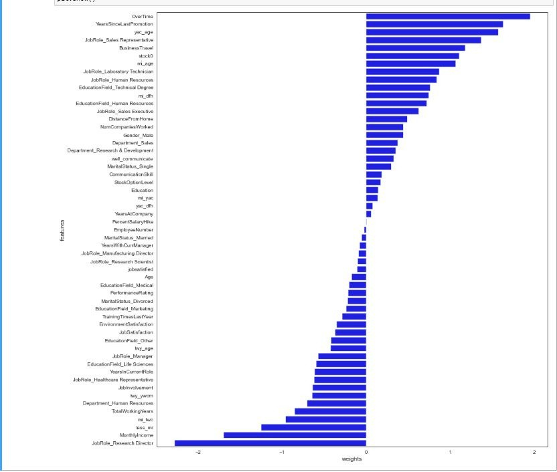
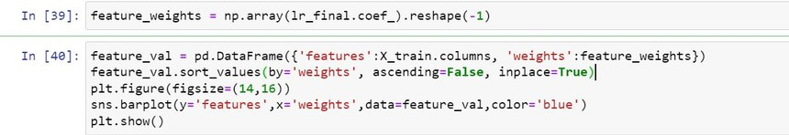
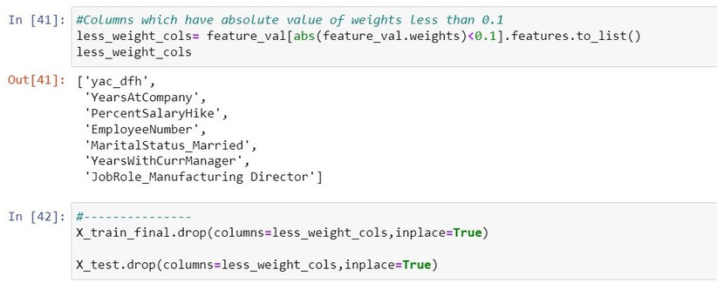
FEATURE SELECTION:
So what is the need of Feature Selection?
* It enables the machine learning algorithm to train faster.
* It reduces the complexity of a model and makes it easier to interpret.
* It improves the accuracy of a model if the right subset is chosen.

Slide 9


ALG0RITHMS USED
We have used KNN, decision tree and logistic regression.
Reason:
WE WILL BE CONSIDERING LOGISTIC REGRESSION AS OUR MAIN MACHINE LEARNING MODEL BECAUSE THERE IS NO ATTRITION MENTIONED IN THE TEST FILE SO KNN AND DECISION TREE ARE NOT PREFERRED AND LOGISTIC REGRESSION IS PREFERRED

Slide 10

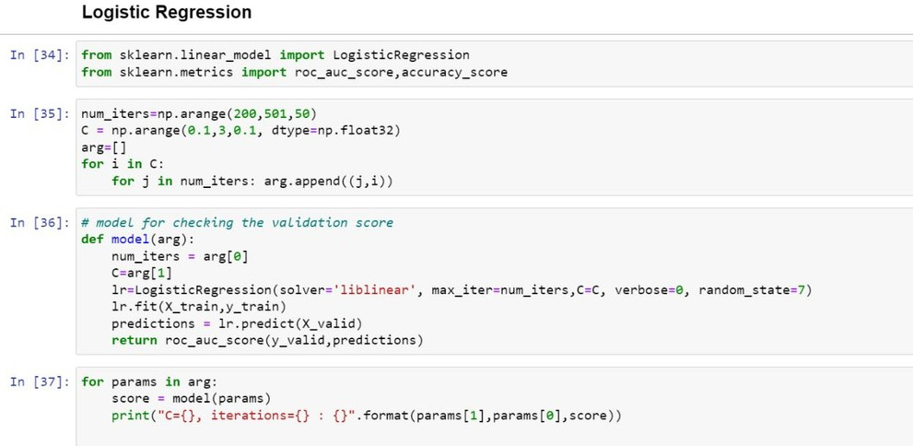
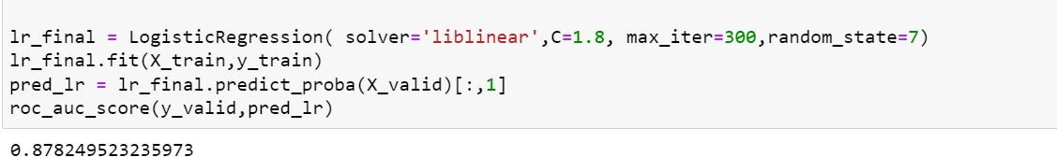
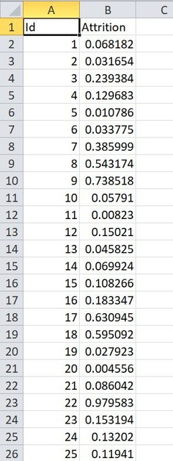
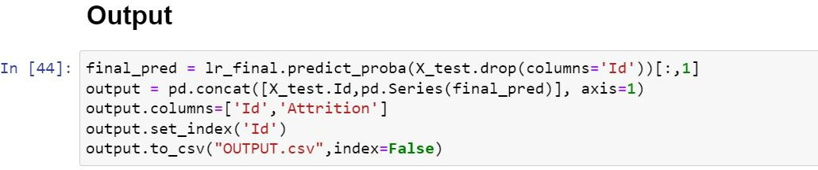
Logistic Regression
RESULT AND ANALYSIS
Output:

Slide 11
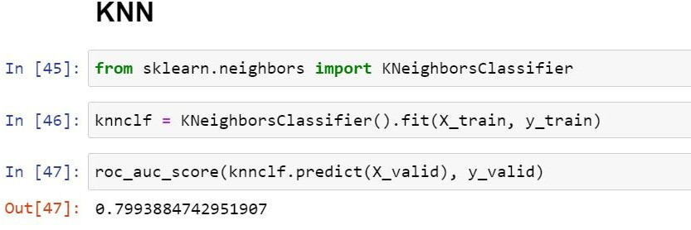
KNN

Slide 12
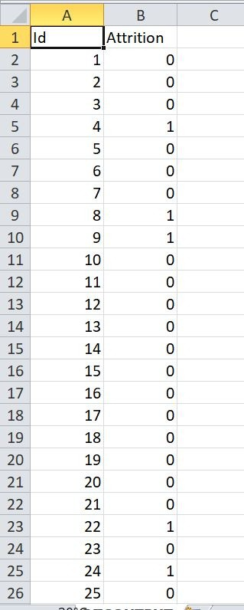
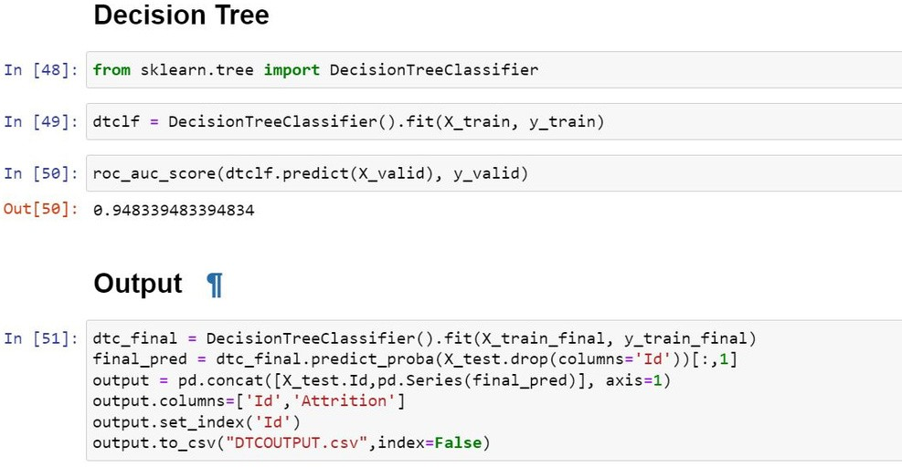
Decision tree
Output:

Slide 13

Conclusion
With our model after analysing the input data we were able to predict the probability of employee attrition table.

